Slide 1
Python + Nitro
ServTech Congress 2014
David Cooper
SE, Networking
David.Cooper@Citrix.com
Brian Tannous
Technology Specialist
Brian.Tannous@Citrix.com
July 28th, 2014

Slide 2
Overview
Introduction to NITRO
Python Basics
Getting Setup with NITRO and Python
Demos

Slide 3
Introduction to NITRO

Slide 4

What is NITRO
NetScaler Interface Through RESTful resources and objects
A way to communicate with NetScaler programmatically
Democratizes the access to NetScaler through a common language
A human readable, http-based interaction
e.g. http://netscaler / nitro / v1 / stat / lbvserver
NITRO SDKs abstract this further still and make it easier to access
Java .NET
Python Perl
REST

Slide 5

Why use NITRO
Data exchange (reads/writes) are passed in a very structured way
Raw and without formatting
One variable, one result
Programs or Scripts can include NetScaler as part of a larger execution
E.g. If server load = max, then tell NetScaler to enable more services
SEs could make their own configuration wizards to automate POCs
Makes NetScaler services more consumable
Essential for datacenter automation/SDN

Slide 6
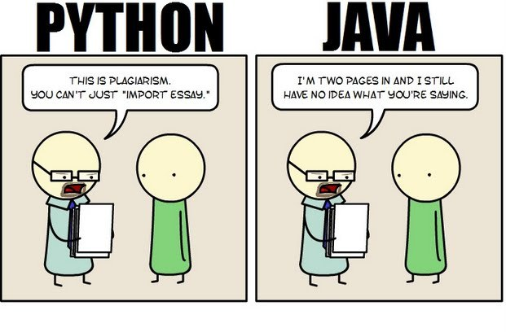
Python vs other NITRO SDK Languages
Easy to read
Easy to write
Approachable for novice programmers
Easy system for code re-use
Faster to build (no compile)
Simple editing tools (IDE not required)

Slide 7
Python Basics

Slide 8
Basic Python rules
Syntax
Spaces
Colons
Parentheses
Square brackets
Curly Braces
Intro.py
list = [9] if function(33) > 9:
list[0]=1
dict={‘new’:1}
print list
Output
[1]
Colon terminates declaration
Indentation for the body of a code block
Parentheses for function parameter passing or tuples
Square brackets for a list
Curly braces for a dictionary

Slide 9
Examples
ifElseWhile.py
a = 20 if a >= 22:
print("if”)
elif a >= 21:
print("elif")
else:
print("else")
while a > 0:
a = a - 1
print(“.”),
output
else
....................
shoppingList.py
sInt = 2
sString = “1 quart”
sList = [‘eggs’, ‘milk’]
sTuple = (‘eggs’, ‘milk’)
sDict = {‘eggs’: sInt, ‘milk’: sString}
sSet = ([‘eggs’, ‘milk’])
print sString
print sInt, sList[0]
if ‘milk’ in sDict:
print “We need”, sDict[‘milk’], “of milk”
output
1 quart
2 eggs
We need 1 quart of milk

Slide 10
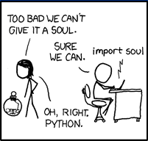
Examples
modules.py
from math import sqrt
print “Square root of 16 is”, sqrt(16)
import requests
r = requests.get(‘http://google.com’)
print r.status_code, r.text
output
Square root of 16 is 4
200 <!doctype html><html itemscope="" itemtype="http:...(Google HTML Source)

Slide 11
Getting Setup with NITRO and Python

Slide 12
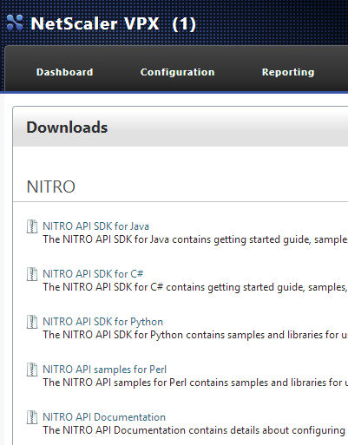
NITRO requirements
NetScaler 10.1 or above
Authentication to NetScaler with enough permissions to execute
Access to NetScaler NSIP/SNIP with Management access enabled
Python interpreter – 2.7.x
included on Mac
Win/Linux, links are in the references
Installing Requests
Via PIP or Easy-Install (pip install requests)
Your favorite editor or IDE
Download and install the NITRO SDK

Slide 13
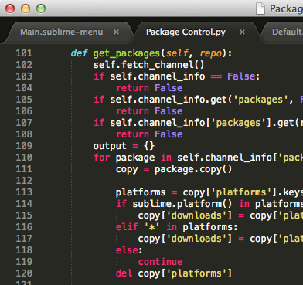
Recommended Tools
Mac
Full IDE
Komodo
PyCharm
Eclipse (PyDev)
NetBeans
Etc…
Lightweight Editors
TextMate + Python bundle
TextWrangler
Sublime + Anaconda
Etc…
Windows
Full IDE
Komodo
PyCharm
Eclipse (PyDev)
NetBeans
Etc…
Lightweight Editors
Sublime + Anaconda
Notepad++
Etc…

Slide 14
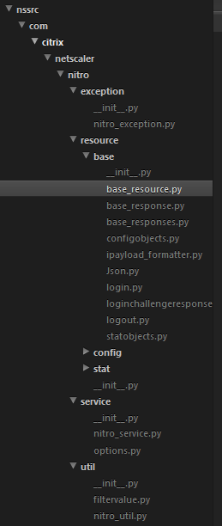
Unpacking the Python SDK
Every NITRO class is stored in a separate file (e.g. vpnvserver)
Main folder groups are stat and config
Code is included for exception handling
You must include each class that you plan to use in your script
You can find classes at /nssrc/com/citrix/netscaler/nitro/resource
Documentation on eDocs (basic instructions)
Install SDK or run code from extracted folder
python setup.py install

Slide 15
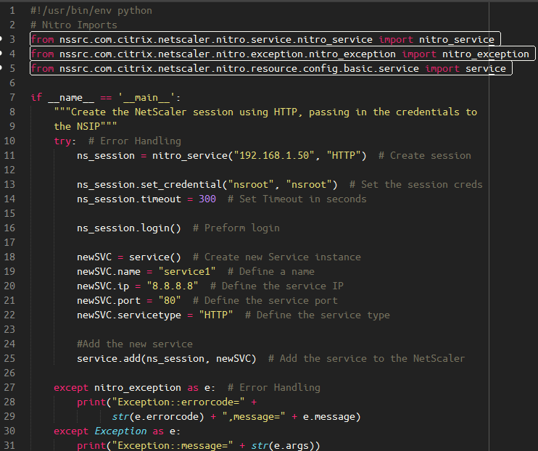
Getting Started with the Python SDK
NITRO_Service is the first order of business
sets up session with IP and authentication
Handles loging in, reboots, savec, ect..
Each class has properties
service.name
Every class has similar methods
service.add
service.get
Methods are called using NITRO object + additional parameters

Slide 16
Demo time

Slide 17
Demo: Modelling CTX139313

Slide 18
Demo: NetScaler Automated Configuration using NITRO

Slide 19
Python and NITRO References

Slide 20

Python / Nitro Tips
Finish a programming tutorial
Write self-documenting code
Work in small sections
Build portable functions
Use comments and output
Use exception or error handling
Use the NetScaler GUI -> Syslog

Slide 21
Resources
Learn to Program
http://www.codecademy.com/tracks/python
http://www.learnpython.org/
http://learnpythonthehardway.org/book/
http://www.cogsci.rpi.edu/~destem/igd/python_cheat_sheet.pdf
https://wiki.python.org/moin/BeginnersGuide/NonProgrammers
Documentation
https://www.python.org/doc/
http://support.citrix.com/proddocs/topic/netscaler-10-5/ns-nitro-wrapper-con.html
IDE/Editors
https://wiki.python.org/moin/IntegratedDevelopmentEnvironments
http://piotr.banaszkiewicz.org/blog/2013/08/24/sublime-text-3-for-python-development/

Slide 22
Resources
Get Python and Nitro
https://www.python.org/
NITRO is available on all NetScalers at http://nsip/menu/dw
Misc
Cisco Coding w/ Python and REST 101: https://citrix.sharefile.com/d-s5656fc50a7b4f679
Download our Demos
https://github.com/btannous/nsAuto

